Slide 1
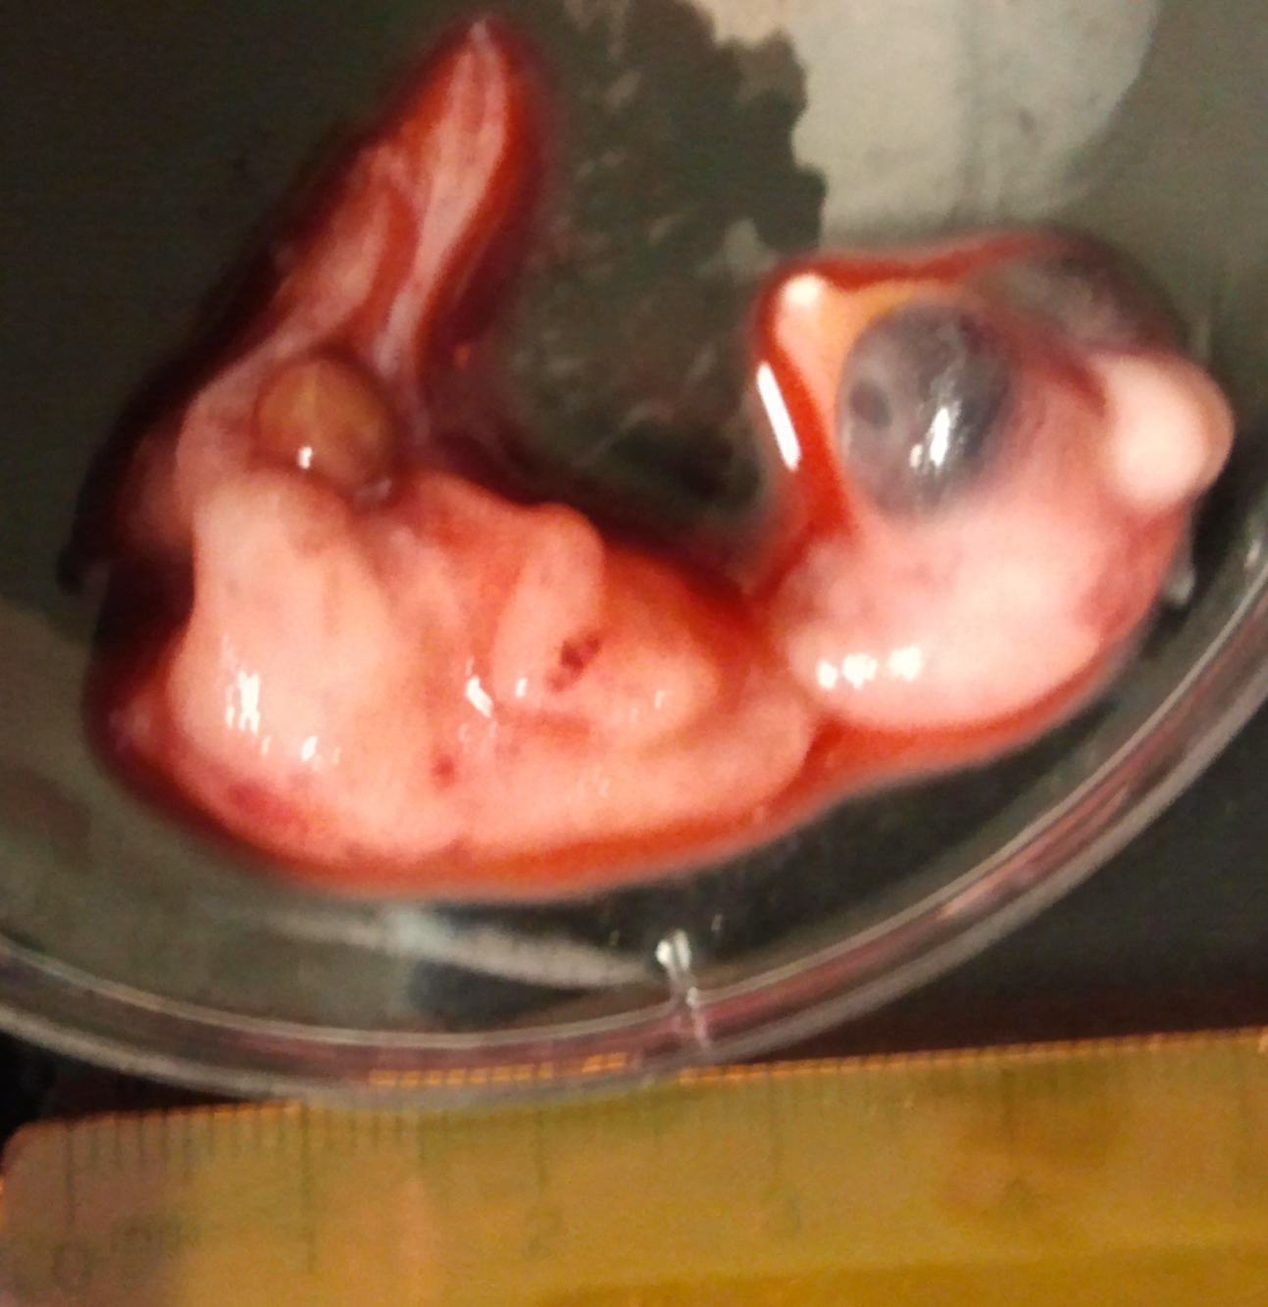


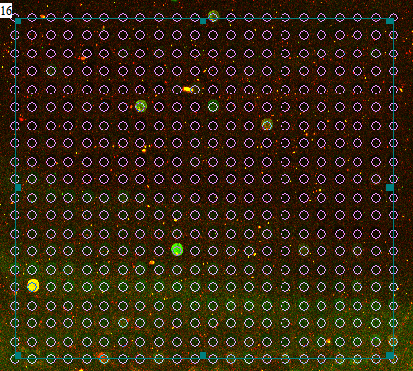
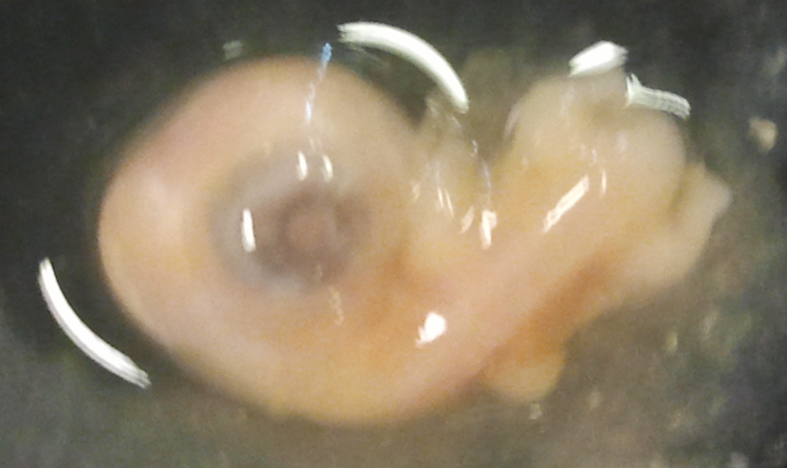
Chicks and Their Genes
A study on the Developmental Impact of Baclofen in Chicken Embryos
Abstract
Many medications are used to help control symptoms of debilitating diseases. Patients with Multiple Sclerosis often take Baclofen to control the muscle spasms associated with the disease. Since the age of onset of MS is typically in the mid to late twenties, many women who develop the disease may be pregnant or breastfeeding during treatment. Baclofen has not been clinically tested in pregnant or breastfeeding mothers as of yet, making it valuable to study the effects of Baclofen on chicken embryo’s development. The drug was injected into five day developing chicken embryos, their brains then were collected after a week of exposure. The mRNA was extracted to indicate gene expression in experimental chicks and control chicks to then be able to compare the amounts of gene expression of many genes within the cells. cDNA was then made and labeled with a capture tag. Microarrays were set up for each sample to determine the amount of up-regulation or down-regulation of genes of interest in response to the drug. We expect and later supported up-regulation of stress coping genes and down-regulation of growth factors based on the fact that the size of the chicken embryos were observed to be smaller as the dosage of Baclofen increased. This experiment indicates that the drug Baclofen, if taken during pregnancy, may cause adverse effects during fetal development. This fact should be taken into account when a woman with MS is considering having a child.
Bethany Kulp and Melissa Moyer
Dr. Ettinger
Diseases of the Nervous System Lab
Cedar Crest College, Allentown PA 18104
Materials and Methods
Injections:
Injections were made by creating a hole at the top of the egg and injecting the solutions into the egg with a needle. We used two concentrations of Baclofen (200 ng/mL and 1000 ng/ml). Table 1 lists the egg number, the weight, the concentration of the injected substance and the injection amount.
Table 1: Egg injections
Microarrays and mRNA prep:
Microarrays and mRNA preparation were done using standard procedures for reverse transcription and microarray slide preparation.
Results
Introduction
Baclofen helps to control the muscle spasms associated with different diseases such as Multiple Sclerosis and a few other diseases. Since the age of onset of MS is typically in the mid to late twenties, many women who develop the disease may be pregnant or breastfeeding during treatment. Baclofen has not been clinically tested in pregnant or breastfeeding mothers as of yet, making it valuable to study the effects of Baclofen on chicken embryo’s development. We specifically focused on the development of the chick’s nervous system. The drug was injected into five day developing chicken embryos, their brains then were collected after a week of exposure. The mRNA was extracted to indicate gene expression in experimental chicks and control chicks to then be able to compare the amounts of gene expression of many genes within the cells. cDNA was reverse transcribed from the mRNA and labeled with a capture tag. Microarrays were set up for each sample to determine the amount of up-regulation or down-regulation of genes of interest in response to the drug. We found that no matter the treatment that the chicks were visibly deformed unless no treatment was given. Since we could visibly see the deformations we used two chicks with the same deformations to study the effects of Baclofen. We observed many regulation differences between the two groups, including genes linked to diseases in the Baclofen chick group. This experiment indicates that the drug Baclofen, if taken during pregnancy, may cause adverse effects during fetal development. This fact should be taken into account when a woman with MS is considering having a child.
Discussion
Baclofen does not seem to be a drug a patient of MS would like to be on when they are pregnant. Evidence for this coming from our experiment is found in the form of the grotesque phenotypes seen in the embryos and the genes that were affected by the drugs presence. Many of the embryos had organs on the outside of their bodies suggesting that development was hindered in these specimens. There were a few that were beginning to be reabsorbed also.
There were many types of genes affected by the presence of Baclofen in the developing environment of these chicken embryos. Many of them were developmental genes such as retinoic acid induced protein, neuron specific genes such as neuron navigator, and energy consumption genes such as ATP synthase and NADH dehydrogenase. It makes sense that these genes would be affected in these cells since they have a big role in development and efficiency of the cell to work and produce the things it needs to carry out its many functions to stay alive. The main genes that we did not see any changes in were ribosomal genes which are important for the production of proteins in the cell. This means that the cell was still able to survive in this environment due to the fact that it could still produce proteins. This is not a surprising find since these proteins are critical for protein synthesis and the cells would die otherwise. Overall the drug is not the best plan for pregnant women and there should be an in depth discussion about the options available if the woman MS patients that want to have children.
Animal Testing
Using animals for the testing of drugs has long been controversial. Many people feel that it is cruel to use them; however, without this testing we would not have the amount of knowledge that we do on many conditions present in the world today nor would we know how to treat most of them. There are strict guidelines as to the use of animals. They are sacrificed humanly so little to no pain is felt by the embryos. It is not right to use animals frivolously for testing, there must be a good reason behind their use that will further societies knowledge.
References

